Slide 1
Week 6 Synchronous Session
Week of Feb 21, 2022

Slide 2
Agenda
Logistics – Milestone #1 meetings this week!
Week 5 Quiz Discussion
Week 4 Assignment Discussion
Week 5 In-Module Exercises Discussion
Looking ahead at Week 6
Guided work time!

Slide 3
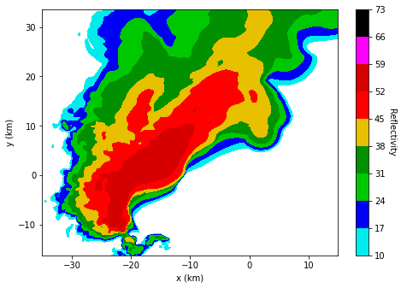
Week 5 Quiz Discussion
What’s missing?

Slide 4
Week 5 Quiz Discussion
What’s missing?
Title
Units for reflectivity
Geospatial information – where are we in United States? Map?
What height are we at?
What time are we at?
Any features to be annotated?

Slide 5
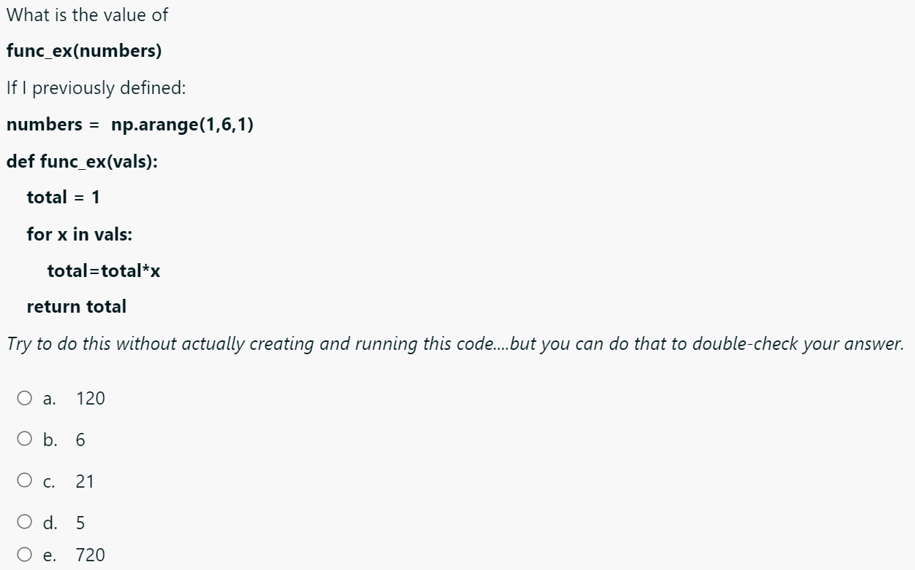
Week 5 Quiz Discussion

Slide 6
Week 5 Quiz Discussion
[1,2,3,4,5]
1*2*3*4*5

Slide 7
Week 4 Assignment Discussion
What is hardwiring and why should it be avoided?
Examples from Week 4 assignment

Slide 8


Week 4 Assignment Discussion
Spatial analysis is IMPORTANT!!
A structured grid – certain # of latitudes, certain # of longitudes
UIUC: we know the lat and lon!
We also know the lat, lon of each gridpoint in our dataset!
lat2
lat2
Minimize this distance, for lat and then for lon!
lat1
lat1

Slide 9
Mapping FAQ
What is the difference between projection and transform? Do I have to define both? (YES!!) Projection: Specifying projection when you set up your map axes before creating actual contour or other plots tells Python what you want the projection of the map itself to be
KEY: this is independent of the coordinate system your data is defined in!!
Transform: Specifying transform when you call your plotting function tells Python the coordinate system your data is defined in….may or may not be the same as your projection…
ALWAYS NEED TO SPECIFY BOTH!!!
Want to read more?: https://scitools.org.uk/cartopy/docs/latest/tutorials/understanding_transform.html

Slide 10
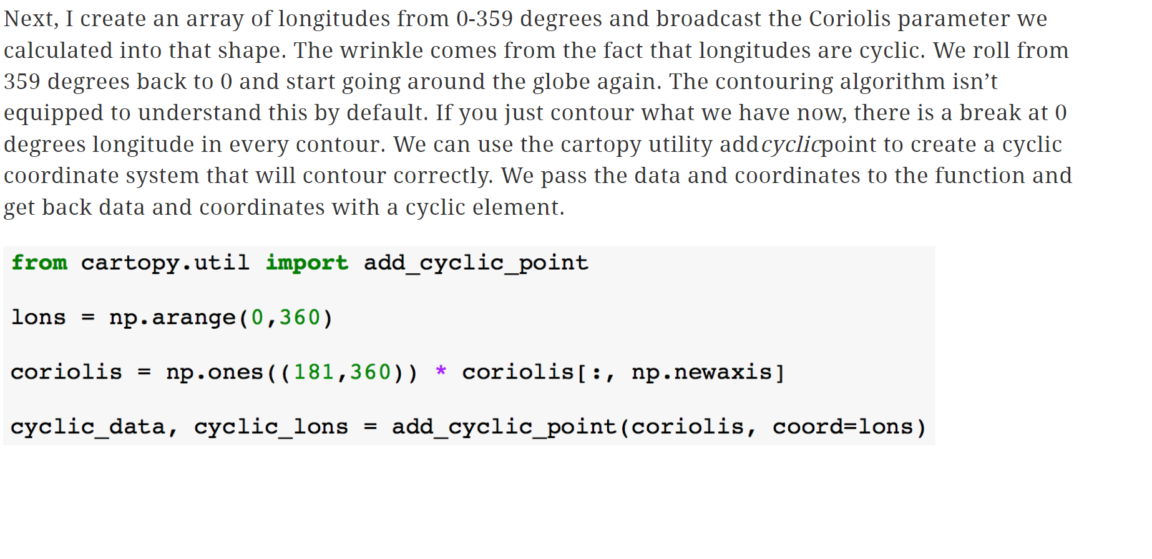
Mapping FAQ
Why do we add a cyclic point to global data?
https://www.unidata.ucar.edu/blogs/developer/en/entry/metpy-mondays-7-contouring-a

Slide 11
Mapping FAQ
Let’s practice converting longitudes

Slide 12
Week 5 In-Module Exercises
KEY PRINCIPLES:
Minimize hardwiring!
Do not start w/ max = 0 – what if temperatures were all negative?
Leverage Pythonic style of for loops, using data itself as the iterator
Instead of iterating through fixed # of points based on size of array
Definitely do NOT hardwire this if you do construct your for loop in that manner, i.e., use size function to evaluate size of your array, etc.
NumPy array indexing – when it comes to indexing, can treat Xarray data structure as NumPy array re: HOW we index – need to know order of dimensions, etc.
Power of Xarray – refer to our dimensions by their names when indexing – more to following in…Week 8

Slide 13
Group coding time….aka guided work time
Options
DOES CARTOPY WORK FOR YOU?
Review Week 4 Assignment Solution/your feedback, Week 5 In-Module Exercises Solution
Start looking at Week 6 materials
Continue thinking about your project in preparation for our meeting this week, or in reflection after!

Slide 14
Week 6: Looking Ahead
Last few weeks: working with spatial data, culminating in some mapping + v. small taste of Xarray
Now: switching gears to Pandas – Pandas and Xarray functionality are similar, but Pandas is more intuitive without complex dimensionality

